Slide 1

Private company management system
Author: nkulu kilumba emmanuel
Научный руководитель: Рудикова Л.В.

Slide 2
Goals and tasks
Goals: Design and implementation of Private company management system
Tasks:
Review and analyze existing software solutions;
Analyze the subject areas and determine the main functions of software products.
Design data models and necessary models of function and models interface;
Design application architecture;
Implementing the server part of the application program;
Implementing the client part of the application (website);
Complete Graduation Documents.

Slide 3
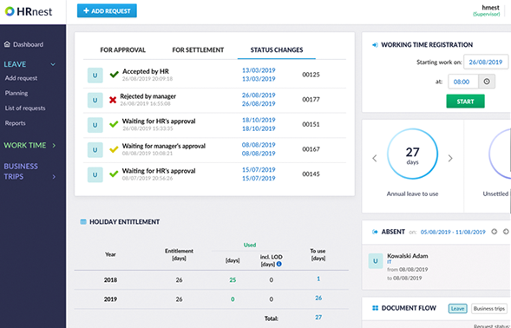
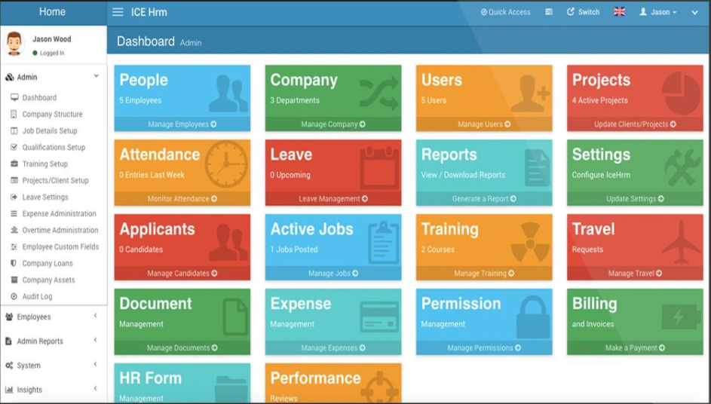
Analysis of existing solutions find similar solutions

Slide 4
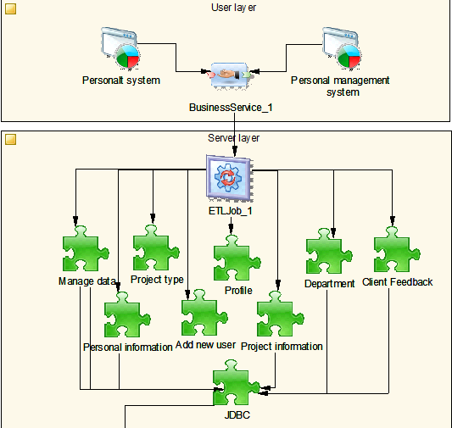
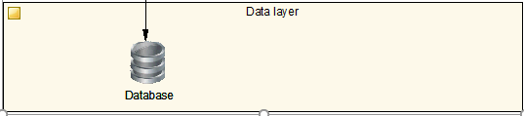
system architecture

Slide 5
Conceptual diagram

Slide 6
System Use Case Diagram

Slide 7
Activity diagram (visitors)
activity diagram visitors

Slide 8
Activity diagram (admin)
activity diagram admin

Slide 9
Activity diagram (manager)
activity diagram user

Slide 10
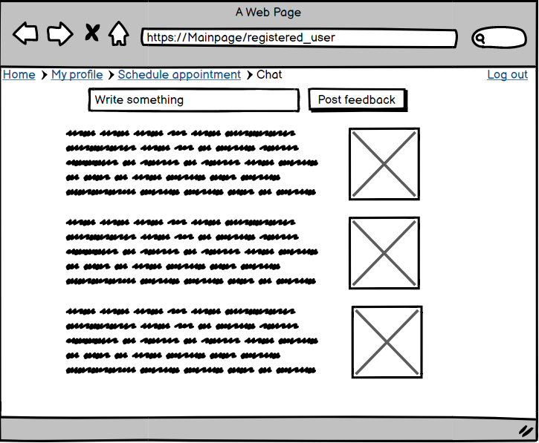
Mockup of Visitor page

Slide 11
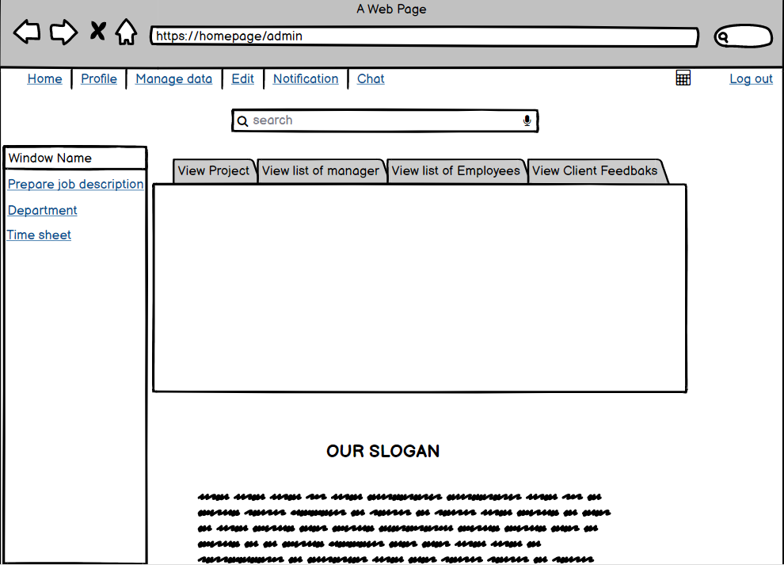
Mockup (for admin)
Admin homepage

Slide 12
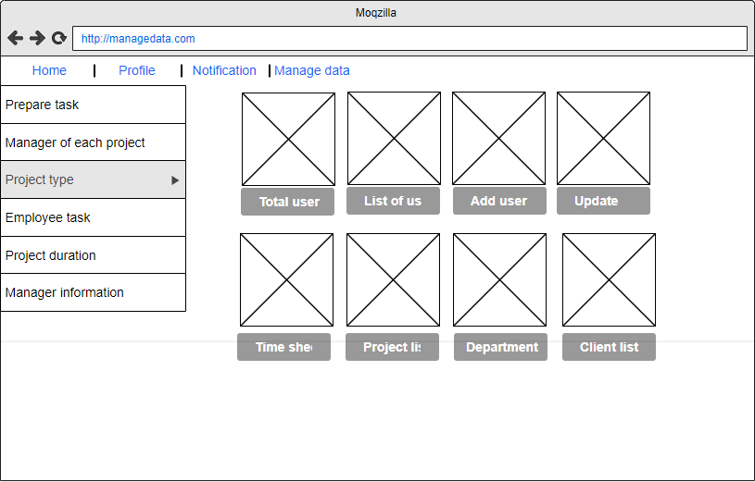
Mockup of for manage page
Administrator manage page

Slide 13
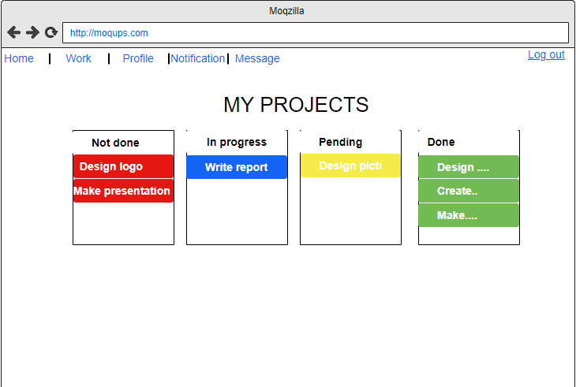
Mockup of Manager homepage
manager work page

Slide 14
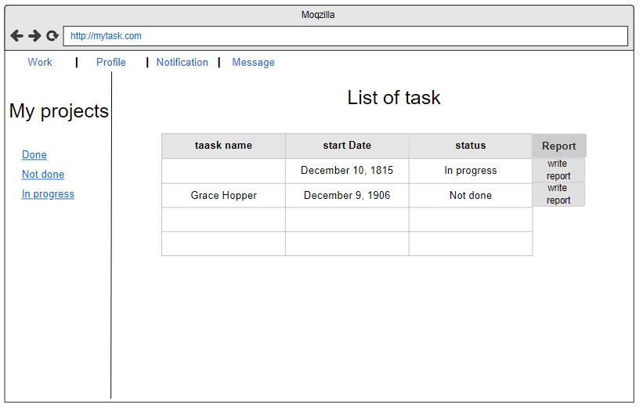
Mockup of Personnel page
Personnel task page

Slide 15
key technology
Bootstrap
Mysql
Java
Html, php，CSS，JS…
Ms Server

Slide 16
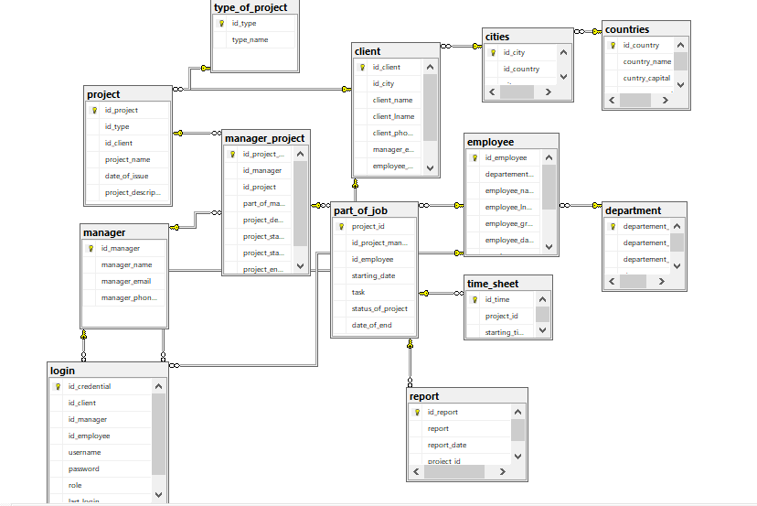
Database Structure

Slide 17
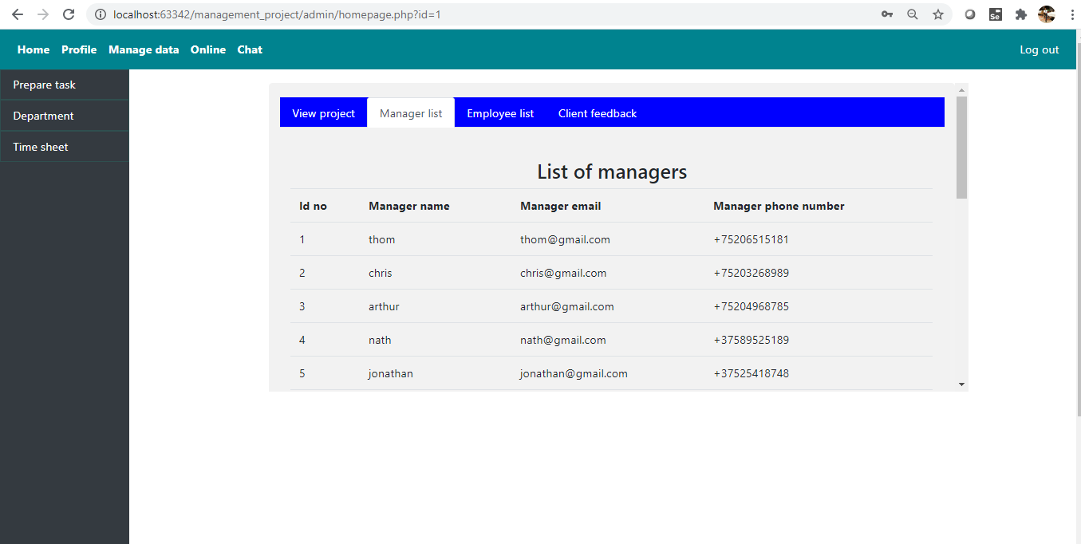
Homepage (screenshot)

Slide 18
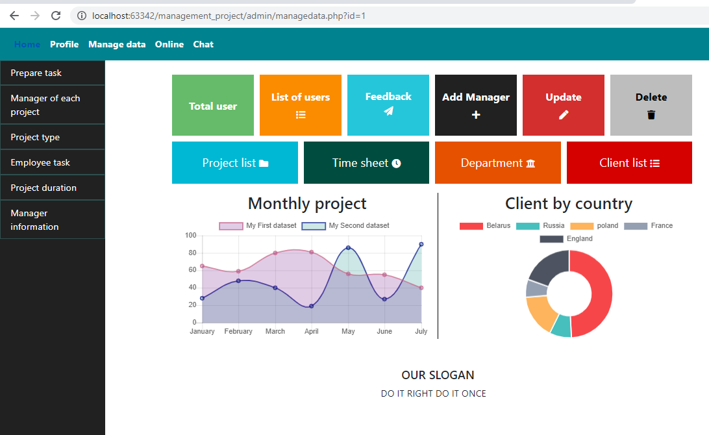
Manage data page (Administrator side) (screenshot)

Slide 19
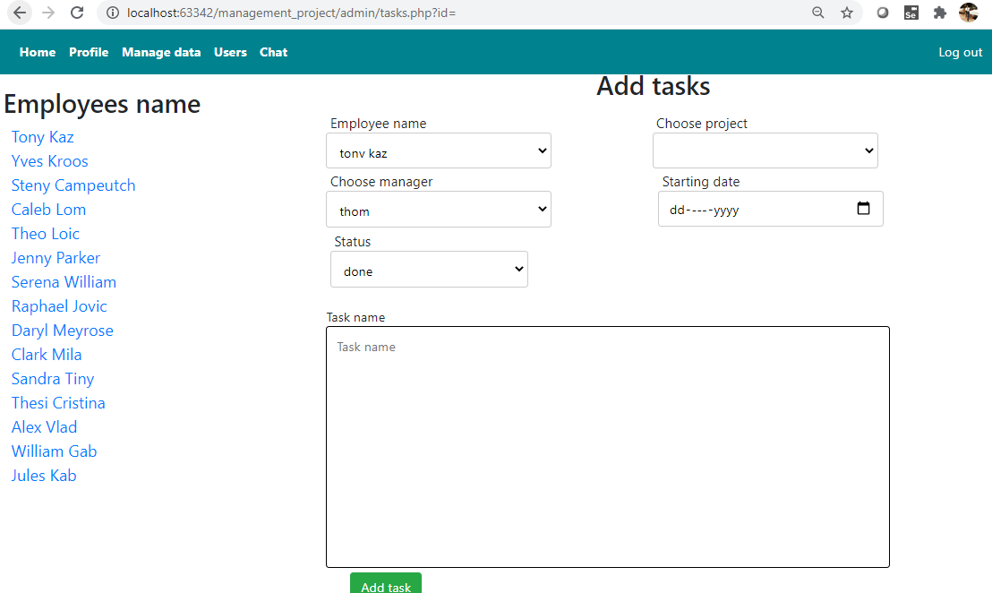
Assign task (screenshot)

Slide 20
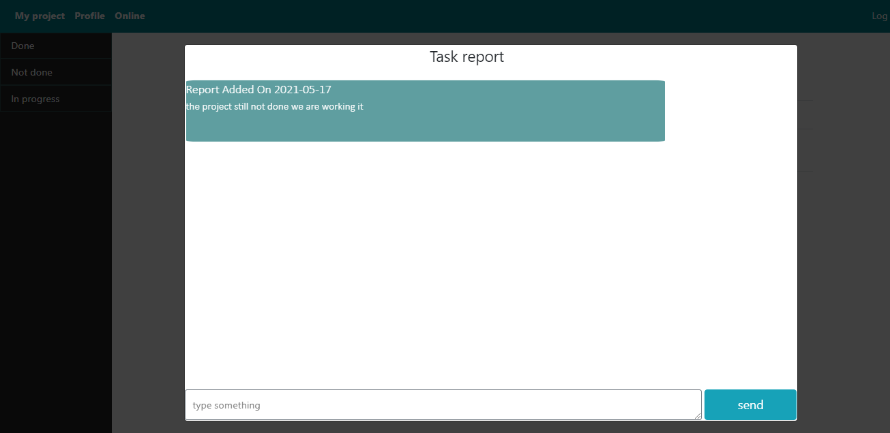
Report modal (screenshot)

Slide 21
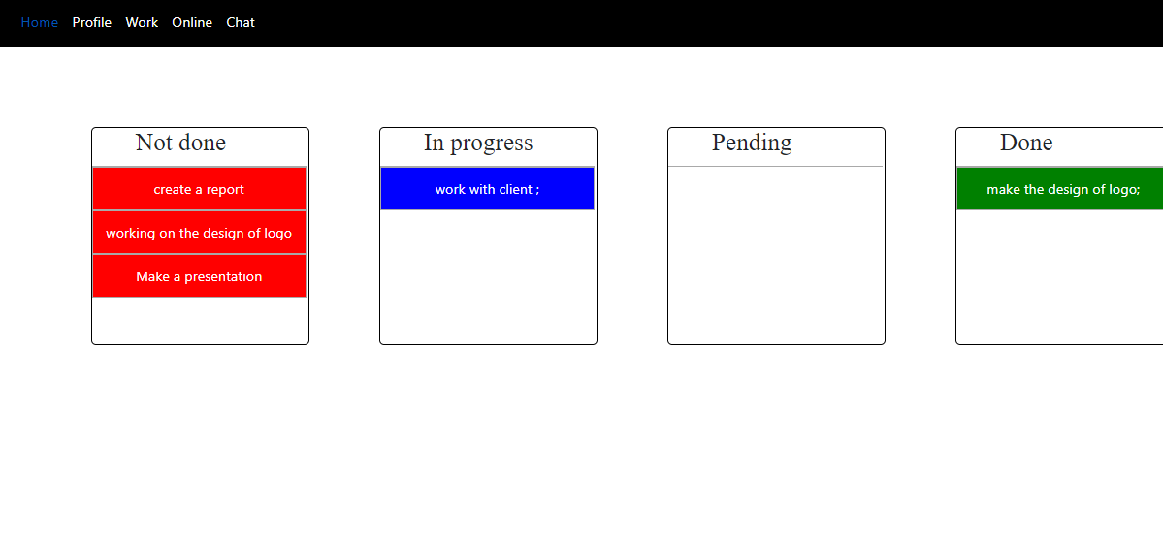
Manager (work page (screenshot))

Slide 22
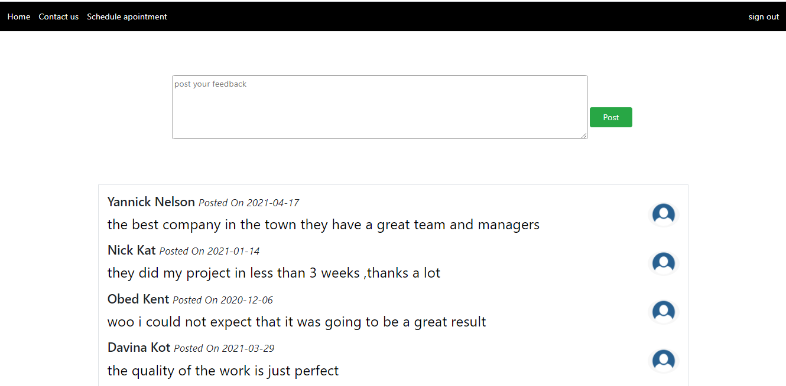
Visitor homepage (screenshot)

Slide 23
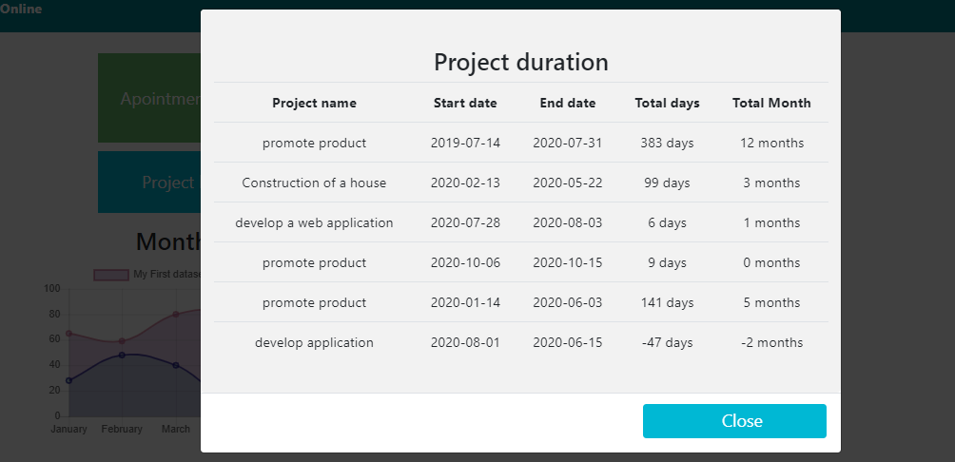
List of projects duration (screenshot)

Slide 24
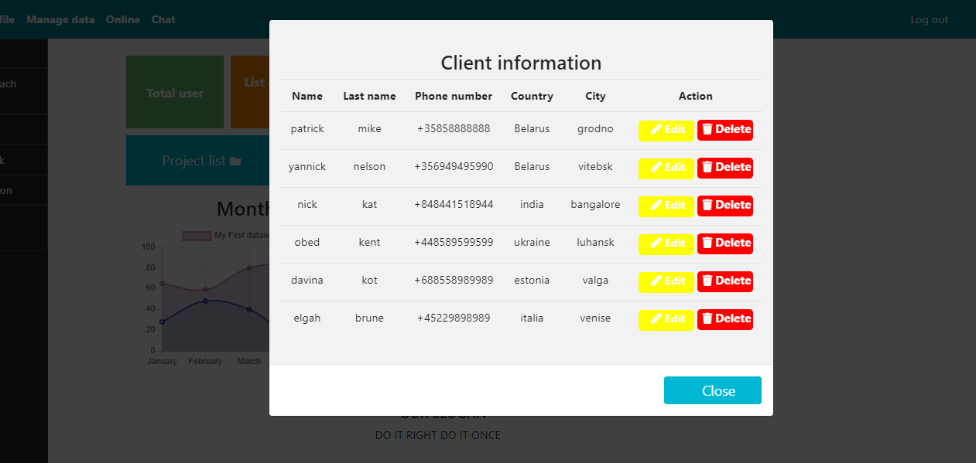
Client information (screenshot)

Slide 25
summary
The following tasks have been accomplished:
The main aspects of the subject field are studied.
Analysis of existing solutions.
The basic requirements of the system have been formed.
Create the system architecture.
Make UML design.
Select the technology to implement the system.

Slide 26

Thank You
someone@example.com

